Slide 1


SUPPLY CHAIN MANAGEMENT SYSTEM SDP-1

Slide 2
BATCH DETAILS
Batch Number : 537
2000031337 - Soumya Prasad
2000031315 – Sampath Kumar
2000031317 – Sai Nirupam

Slide 3
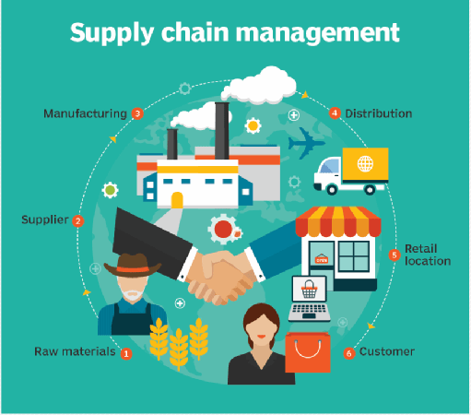
WHAT IS SUPPLY CHAIN MANAGEMENT?
Supply chain management (SCM) is the integration of key business processes from the end users through original suppliers that provides products, services and information that add value for customers and other stake holders.

Slide 4
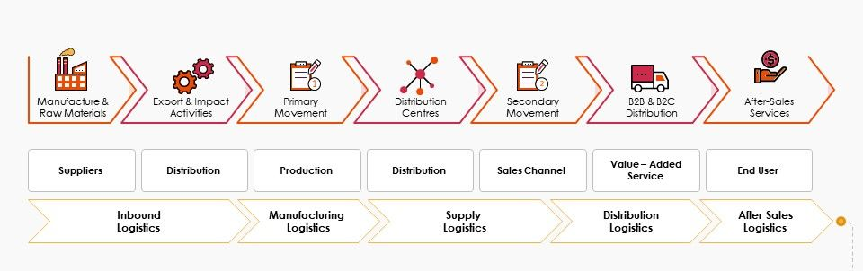
BASIC SUPPLY CHAIN PROCESS.

Slide 5
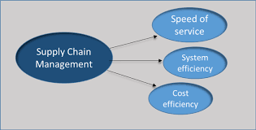
WHY IS SCM SO IMPORTANT?
To Gain efficiencies from procurement, distribution and logistics
To reduce transportation ,costs of inventories
To meet the challenge of globalization and longer supply chains.
To meet the new challenges
To manage the complexities
To manage the inventories needed

Slide 6
IMPORTANT ACTIVITIES INCLUDE DETERMINING
Transportation vendors.
Credit and cash transfers.
Accounts payable and receivable.
Sharing customer, forecasting, and production information.
Suppliers
Warehousing and inventory

Slide 7
MERITS OF SCM
COST EFFICIENCY
ENHANCE OUTPUT
AVOIDS DELAY IN PROCESS
EASILY IDENTIFY PROBLEMS
BETTER COLLABORATION

Slide 8
DEMERITS OF SCM
DIFFICULT AND EXPENSIVE TO IMPLEMENT
REQUIRES TRAINED STAFF
LACK OF RELIABILITY

Slide 9
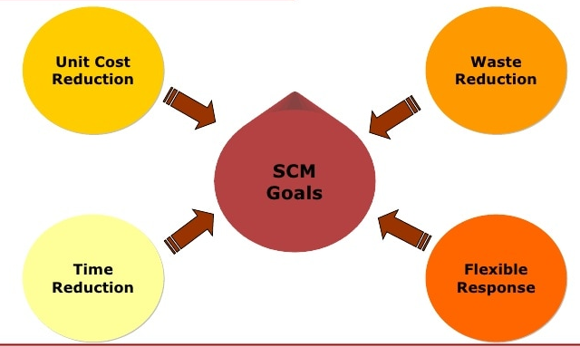
OBJECTIVE AND GOALS OF SCM
Increase profits.
Improve relationships with customers and suppliers
right products in the right quantities (at the right place) at the right moment
Competitive edge.
Reduced inventory, lead times and warehouse cost

Slide 10
SUPPLY CHAIN RISKS
More reliance means more risk.
Fewer suppliers increase dependence.
Compounded by globalization and logistical complexity.
Vendor reliability and quality risks .
Political and currency risk.
Climate change risks.

Slide 11
SUMMARY
Segmentation of customers based on service needs.
Customization of logistics network.
Listen to signals of market demand and plan accordingly.
Differentiate product close to the customer.
Develop a supply chain wide technology strategy.

Slide 12


